Slide 1
Activity planning
Module:3

Slide 2

Objectives of Activity planning
Produce an activity plan for a project
Estimate the overall duration of a project
Create a critical path and a precedence network for a project

Slide 3

6.1 Introduction An Schedule in a Project Plan [1/2]
Ensure that the appropriate resources will be available precisely when required
Avoid different activities competing for the same resources at the same time
Produce a detailed schedule showing which staff carry out each activity

Slide 4
6.1 Introduction An Schedule in a Project Plan [2/2]
Produce a detailed plan against which actual achievement may be measured
Produce a timed cash flow forecast
Replan the project during its life to correct drift from the target

Slide 5
6.2 The Objectives of Activity Planning
Providing project and resource schedules
Feasibility assessment: is a project possible within required timescales?
Resource allocation: what are the most effective way of allocating resources?
Detailed costing: How much will the project cost and when is that expenditure to take place?
Motivation: Providing targets is an effective way of motivating staff
Coordination: when do other staff (in other departments) need to be available?

Slide 6


6.2 The Objectives of Activity Planning Activity Planning and Scheduling Techniques
emphasis on
completing the project in a minimum time at an acceptable cost
meeting a set target dates at minimum cost
One effective way of shortening project duration is to carry out activities in parallel
Not all activities can be carried out in parallel

Slide 7
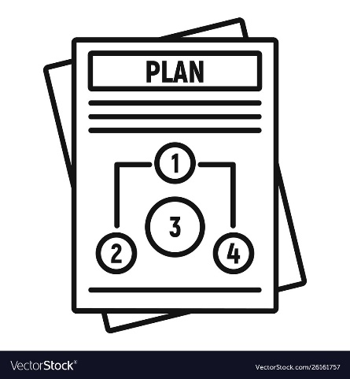
6.3 When to Plan
Planning is an ongoing process of refinement
Each iteration becoming more detailed and more accurate than the last
Over successive iterations, the emphasis and purpose of planning will shift
Timescales, risks, resource availability, cash flow control …

Slide 8

6.4 Project Schedules
A project schedule is a detailed project plan showing dates when each activity should start and finish and when and how much of each resource will be required
Creating a project schedule comprises four main stages

Slide 9
6.4 Project Schedule Four Main Stages
Constructing an ideal activity plan
What activities need to be carried out and in what order
Risk analysis
Identifying potential problems
Resource allocation
The expected availability of resources might place constraints on when certain activities can be carried out
Schedule production
publish a project schedule, which includes planned start and completion dates and a resource requirements statement for each activity.

Slide 10
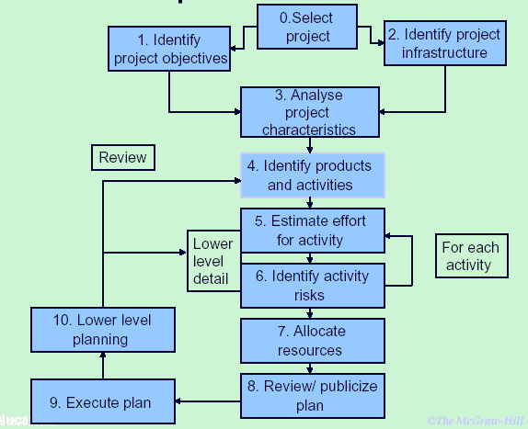
6.4 Project Schedules Step Wise Revisited

Slide 11
6.5 Projects And Activities Defining Project and Activities [1/2]
A project is composed of a number of interrelated activities
A project may start when at least one of its activities is ready to start
A project will be completed when all of the activities it encompasses have been completed

Slide 12
6.5 Projects And Activities Defining Project and Activities [2/2]
An activity must have a clearly defined start and a clearly defined end-point
If an activity requires a resource then that resource requirement must be forecastable
The duration of an activity must be forecastable
Some activities might require that others are completed before they can begin

Slide 13
6.5 Projects And Activities Identifying Activities
Three approaches to identifying the activities or tasks that make up a project.
Activity-based approach
The product-based approach
Hybrid approach

Slide 14
6.5 Projects And Activities The Activity-Based Approach
Consists of creating a list of all the activities
A brainstorming session involving the whole project team
An analysis of past projects
When listing activities, it might be helpful to sub-divide the project into the main life-style stages and consider each of these separately

Slide 15
6.5 Projects And Activities Work Breakdown Structure (WBS) [1/3]
Creating a WBS is a much favored way of generating a task list
Involves identifying the main (or high level) tasks required to complete a project and then breaking each of these down into a set of lower-level tasks

Slide 16
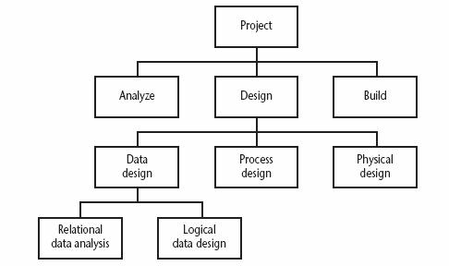
6.5 Projects And Activities Work Breakdown Structure (WBS) [2/3]
A fragment of an activity-based Work Breakdown Structure

Slide 17
6.5 Projects And Activities Work Breakdown Structure (WBS) [3/3]
Need to consider the final level of detail or depth of the structure
Too great of depth will result in a large number of small tasks
Too shallow structure will provide insufficient detail for project control
Each branch should be broken down at least to a leaf where each leaf may be assigned to an individual or responsible team

Slide 18
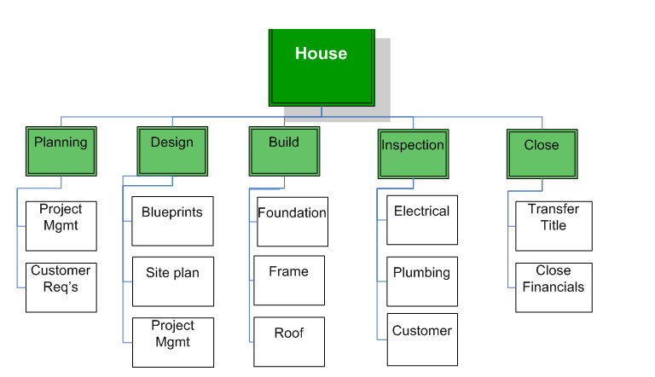
WBS - Examples

Slide 19
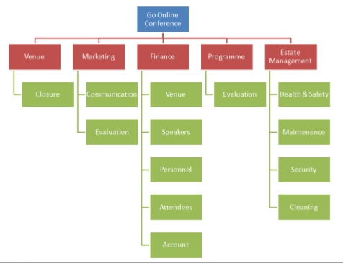
WBS - Examples

Slide 20
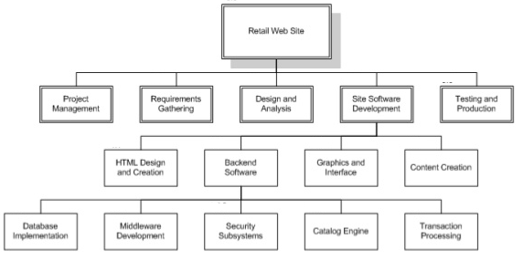
WBS - Examples

Slide 21
6.5 Projects And Activities Advantages of WBS
Much more likely to result in a task catalog that is complete and is composed of non-overlapping activities
Represents a structure that may be refined as the project proceeds

Slide 22
6.5 Projects And Activities 2. The Product-Based Approach [1/3]
Consists of producing a Product Breakdown Structure (PBS) and a Product Flow Diagram (PFD)
The PFD indicates, for each product, which other products are required as inputs
Easily transformed into an ordered list of activities

Slide 23
6.5 Projects And Activities The Product-Based Approach [2/3]
Proponents claim that it is less likely that a product will be left out of a PBS than that an activity might be omitted from an unstructured activity list
Particularly appropriate if using a life cycle methodology such as waterfall
Clearly specifies, for each step or task, each of the products required and the activities required to produce it

Slide 24
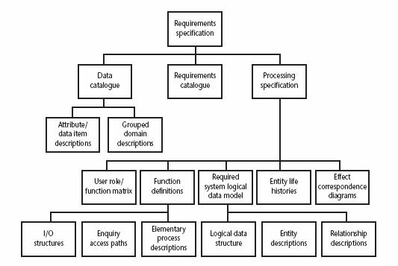
6.5 Projects And Activities The Product-Based Approach [3/3]
A set of generic PBS for each stage in SSDAM
(Structured Systems Analysis and Design Method)

Slide 25
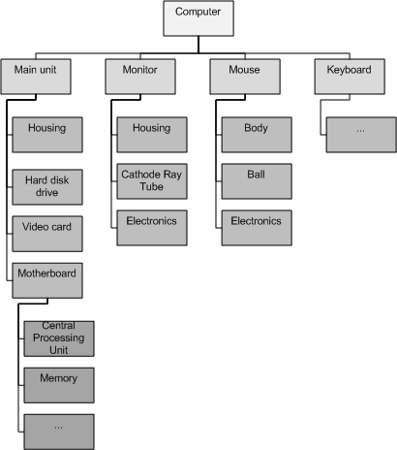
PBS Examples

Slide 26
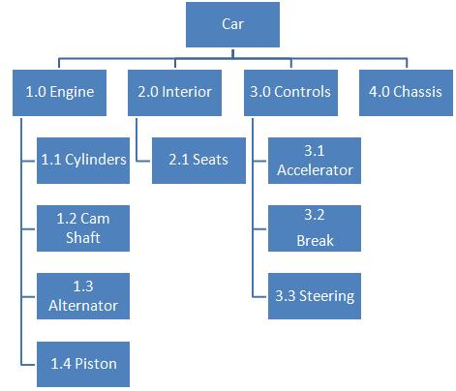
PBS Examples

Slide 27
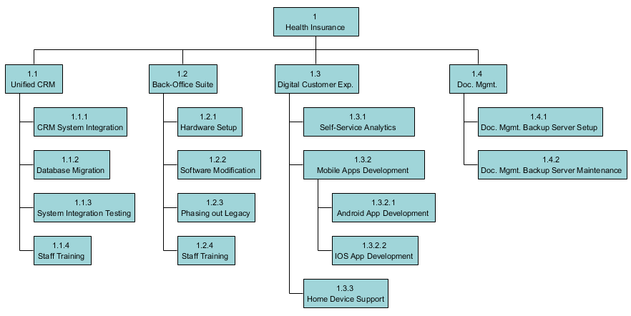
More Examples

Slide 28
6.5 Projects And Activities 3. The Hybrid Approach [1/3]
An alternative WBS based on
A simple list of final deliverables
For each deliverable, a set of activities required to produce that product
As with a purely activity-based WBS, having identified the activities, we are then left with the task of sequencing them

Slide 29
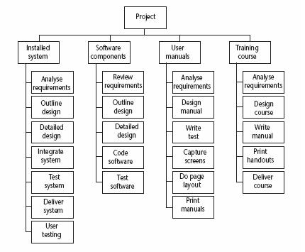
6.5 Projects And Activities The Hybrid Approach [2/3]
A WBS based on deliverables

Slide 30
6.5 Projects And Activities The Hybrid Approach [3/3]
IBM recommended the following five levels for WBS
Level 1: Project
Level 2: Deliverables – such as software, manuals and training courses
Level 3: Components - modules and tests required to produce the system software
Level 4: Work-packages - major work items or collections of related tasks, required to produce a component
Level 5: Tasks - responsibility of a single person

Slide 31
6.7 Network Planning Models
Sequencing the tasks according to their logical relationship, and then scheduling them taking into account resources and other factor
Modeling the project’s activities and their relationship as a network
Time flows from left to right
Originally developed in the 1950’s
Two best known: CPM (Critical Path Method) and PERT (Program Evaluation Review Technique)
Recent Approach is Precedence Network.

Slide 32
6.7 Network Planning Models Activity-On-Arrow [1/2]
Used by CPM (Critical Path Method) and PERT (Program Evaluation Review Technique) to visualize the project as a network
Activities are drawn as arrow joining circles, or nodes, which represent the possible start and/or completion of an activity or set of activities

Slide 33
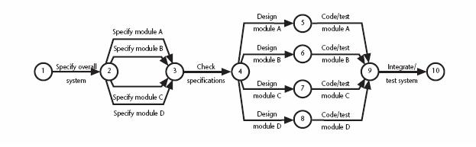
6.7 Network Planning Models Activity-On-Arrow [2/2]
Project activity network fragment represented as a CPM network

Slide 34
6.7 Network Planning Models Activity-On-Node [1/2]
Used by precedence (sequence)networks
Has become popular
Widely adopted
Activities are represented as nodes
The links between nodes represent precedence (or sequencing) requirements

Slide 35
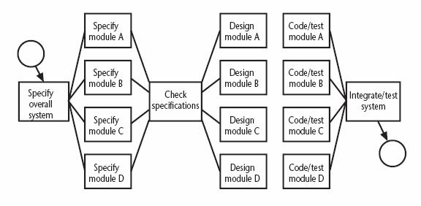
6.7 Network Planning Models Activity-On-Node [2/2]
Fragment of a network developed as an activity-on-node network

Slide 36
6.8 Formulating A Network Model Constructing Precedence Network Rules [1/2]
A project network should have only one start node
More than one activity starting at once? Invent a ‘start’ activity with zero duration
A project network should have only one end node
If necessary, invent an ‘end’ activity
A node has duration
Links normally have no duration

Slide 37
6.8 Formulating A Network Model Constructing Precedence Network Rules [2/2]
Precedents are the immediate preceding activities
All have to be completed before an activity can be started
Time moves from left to right
A network may not contain loops
A network should not contain dangles
If necessary, connect to the final node

Slide 38
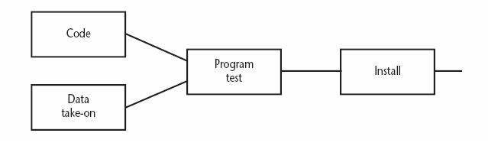
6.8 Formulating A Network Model Fragment of Precedence Network
Installation cannot start until program testing is completed
Program test cannot start until both code and data take-on have been completed

Slide 39
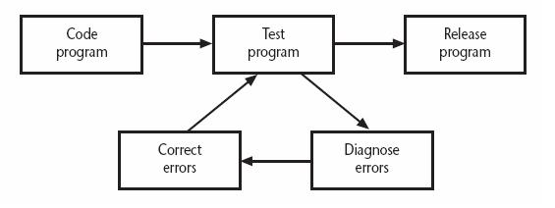
6.8 Formulating A Network Model Network Contains Loop
A loop is an error in that it represents a situation that cannot occur in practice
Program testing cannot start until errors have been corrected?

Slide 40
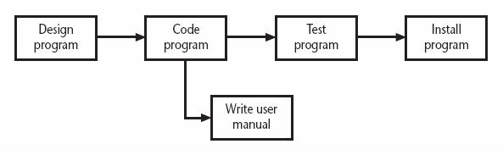
6.8 Formulating A Network Model A Dangle
A dangling activity such as “write user manual” should not exist as it is likely to lead to errors in subsequent analysis

Slide 41
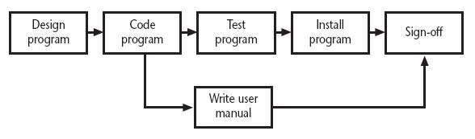
6.8 Formulating A Network Model Resolving The Dangle
The figure implies that the project is complete once the software has been installed and the user manual written
We should redraw the network with a final completion activity

Slide 42
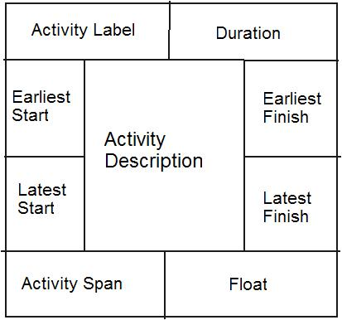
6.8 Formulating A Network Model Labelling Convention
There are a number of differing conventions that have been adopted
Example

Slide 43
6.9 Adding The Time Dimension
The critical path approach
Planning the project in such way that it is completed as quickly as possible
Identifying delayed activities
The method requires the estimation of duration of each activity
Forward pass: calculate the earliest dates at which activities may commence and the project completed
Backward pass: calculate the latest start dates for activities and the critical path

Slide 44
6.9 Adding The Time Dimension Example of Estimated Activity Duration of A Project
Activity |  | Duration (weeks) | Precedents
A | Hardware selection | 6
B | Software design | 4
C | Install hardware | 3 | A
D | Code & test software | 4 | B
E | File take-on | 3 | B
F | Write user manuals | 10
G | User training | 3 | E, F
H | Install & test system | 2 | C,D

Slide 45
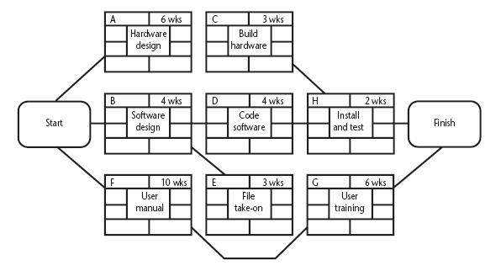
6.9 Adding The Time Dimension The Precedence Network of The Example Project
Activity | Precedence | Duration (week)
A | - | 6
B | - | 4
C | A | 3
D | B | 4
E | B | 3
F | - | 10
G | E,F | 3
H | C,D | 2

Slide 46
6.10 The Forward Pass The Calculation of Earliest Start Date [1/4]
Activities A, B and F may start immediately
The earliest date for their start is zero
Activity A will take 6 weeks
The earliest it can finish is week 6
Activity B will take 4 weeks
The earliest it can finish is week 4
Activity F will take 10 weeks
The earliest it can finish is week 10

Slide 47
6.10 The Forward Pass The Calculation of Earliest Start Date [2/4]
Activity C can start as soon as A has finished
Its earliest start date is week 6
It will take 3 weeks, so the earliest it can finish is week 9
Activities D and E can start as soon as B is complete
The earliest they can each start is week 4
Activity D will take 4 weeks, so the earliest it can finish is week 8
Activity E will take 3 weeks, so the earliest it can finish is week 7

Slide 48
6.10 The Forward Pass The Calculation of Earliest Start Date [3/4]
Activity G cannot start until both E and F have been completed
It cannot start until week 10 - the later of weeks 7 (activity E) and 10 (for activity F)
It takes 3 weeks and finishes in week 13
Similarly, activity H cannot start until week 9 – the later of the two earliest finished dates for the preceding activities C and D

Slide 49
6.10 The Forward Pass The Calculation of Earliest Start Date [4/4]
The project will be complete when both activities H and G have been completed
The earliest project completion date will the later of weeks 11 and 13 – that is, week 13

Slide 50
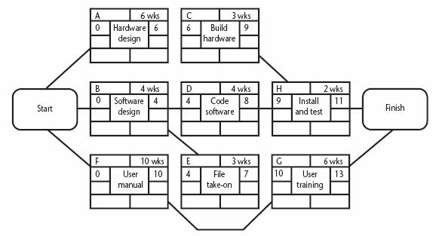
6.10 The Forward Pass The Network After The Forward Pass

Slide 51
6.10 The Forward Pass The Network After The Forward Pass
Activity | Precedence | Duration (week)
A | - | 6
B | - | 4
C | A | 3
D | B | 4
E | B | 3
F | - | 10
G | E,F | 3
H | C,D | 2

Slide 52
6.11 The Backward Pass The Latest Activity Dates Calculation [1/3]
The latest completion date for activities G and H is assumed to be week 13
Activity H must therefore start at week 11 at the latest (13-2) and the latest start date for activity G is week 10 (13-3)
The latest completion date for activities C and D is the latest date at which activity H must start – that is week 11
The latest start date of week 8 (11-3), and week 7 (10-3) respectively

Slide 53
6.11 The Backward Pass The Latest Activity Dates Calculation [2/3]
Activities E and F must be completed by week 10
The earliest start dates are weeks 7 (10-3) and 0 (10-10) respectively
Activity B must be completed by week 7 (the latest start date for both activities D and E)
The latest start is week 3 (7-4)

Slide 54
6.11 The Backward Pass The Latest Activity Dates Calculation [3/3]
Activity A must be completed by week 8 (the latest start date for activity C)
Its latest start is week 2 (8-6)
The latest start date for the project start is the earliest of the latest start dates for activities A, B and F
This week is week zero
It tells us that if the project does not start on time it won’t finish on time

Slide 55
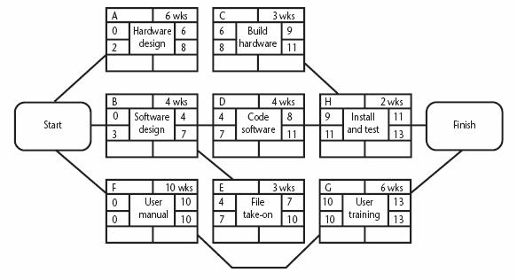
6.11 The Backward Pass The Network After The Backward Pass

Slide 56
6.11 The Backward Pass The Network After The Backward Pass
Activity | Precedence | Duration (week)
A | - | 6
B | - | 4
C | A | 3
D | B | 4
E | B | 3
F | - | 10
G | E,F | 3
H | C,D | 2

Slide 57
6.12 Identifying The Critical Path The Critical Path [1/3]
Critical path: One path through the network that defines the duration of the project
Any delay to any activity of this critical path will delay the completion of the project

Slide 58
6.12 Identifying The Critical Path The Critical Path [2/3]
Activity’s float: the difference between an activity’s earliest start date and its latest start date (or, equally, the difference between its earliest and latest finish dates)
A measure of how much the start date or completion of an activity may be delayed without affecting the end date of the project
Activity span: the difference between the earliest start date and the latest finish date
Measure of maximum time allowable for the activity

Slide 59
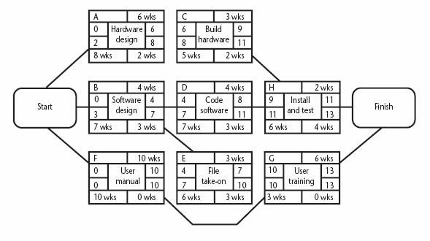
6.12 Identifying The Critical Path The Critical Path [3/3]

Slide 60
6.12 Identifying The Critical Path The Significance of The Critical Path
In managing the project, we must pay particular attention to monitoring activities on the critical path
The effects on any delay or resources unavailability are detected and corrected at the earliest opportunity
In planning project, it is the critical path that we must shorten if we are to reduce the overall duration of the project

Slide 61
6.13 Activity Float Other Measures of Activity Float
Free float: the time by which an activity may be delayed without affecting subsequent activity
The difference between the earliest completion for the activity and the earliest date of the succeeding activity
Interfering float: the difference between total float and free float
Tells us how much the activity may be delayed without delaying project end date

Slide 62
6.14 Shortening The Project Duration
Reduce activity duration
Applying more resources to the task
Working overtime
Procuring additional staff
The critical path indicates where we must look to save time
From previous example, we can complete the project in week 12 by reducing the duration of activity F by one week

Slide 63
6.16 Activity-On-Arrow Networks
Originally used by CPM and PERT methods
Now less common than activity-on-node, still used and introduces an additional useful concept – that of events
Activities are represented by links (or arrows) and the nodes represent events

Slide 64
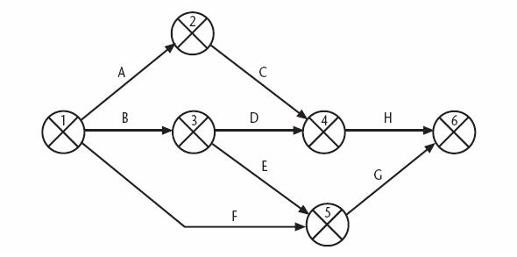
6.16 Activity-On-Arrow Networks Activity-On-Arrow Network of the Example Project

Slide 65
6.16 Activity-On-Arrow Networks Activity-On-Arrow Rules and Conventions [1/2]
A project network may have only one start node
A project network may have only one end node
A link has duration
Nodes have no duration
Time moves from left to right
Nodes are numbered sequentially

Slide 66
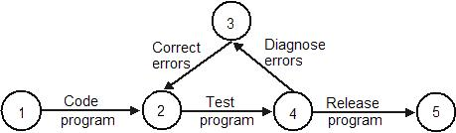
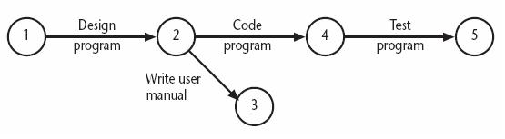
6.16 Activity-On-Arrow Networks Activity-On-Arrow Rules and Conventions [2/2]
A network may not contain loop
A network may not contain dangle

Slide 67
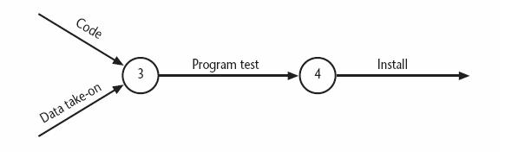
6.16 Activity-On-Arrow Networks Fragment of A CPM Network - Events
Node 3 is the event that both ‘coding’ and ‘data take-on’ have been completed and activity ‘program test’ is free to start

Slide 68
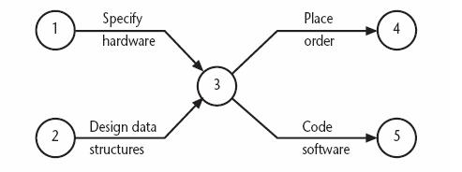
6.16 Activity-On-Arrow Networks Using Dummy Activities [1/3]
A logical error occurs when two paths (‘specify hardware’ and ‘design data structure’) within a network have a common event although they are independent

Slide 69
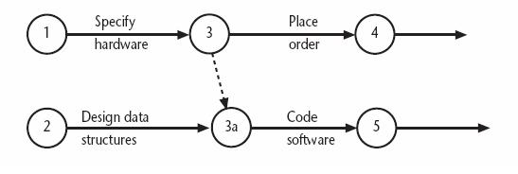
6.16 Activity-On-Arrow Networks Using Dummy Activities [2/3]
Separating the two independent paths and introducing a dummy activity to link the completion of ‘specify hardware’ to the start of the activity ‘code software’

Slide 70
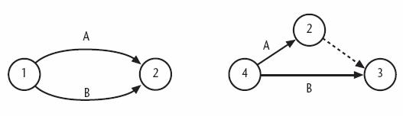
6.16 Activity-On-Arrow Networks Using Dummy Activities [3/3]
Dummy activities, shown as dotted lines on the network diagram, have zero duration and use no resources
They are often used to aid in the layout of network

Slide 71
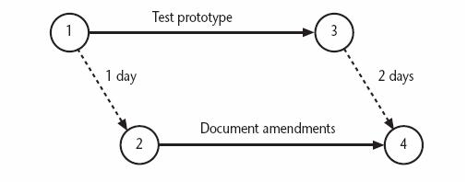
6.16 Activity-On-Arrow Networks Representing Lagged Activities
When parallel activities have time lag, we can represent them with pairs of dummy activities

Slide 72
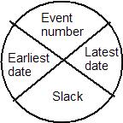
6.16 Activity-On-Arrow Networks Activity Labelling
Typically the diagram is used to record information about the events rather than activities
One of the more common is to divide the node circle in quadrants

Slide 73
6.16 Activity-On-Arrow Networks Network Analysis
Analysis proceeds in the same way as with activity-on-node networks
The discussion places emphasis on the events rather than activity start and completion time
Stages
The forward pass
The backward pass
Identifying the critical path

Slide 74
Activity-On-Arrow Networks
Activity |  | Duration (weeks) | Precedents
A | Hardware selection | 6
B | Software design | 4
C | Install hardware | 3 | A
D | Code & test software | 4 | B
E | File take-on | 3 | B
F | Write user manuals | 10
G | User training | 3 | E, F
H | Install & test system | 2 | C,D
Initial Network Diagram

Slide 75
Initial activity table
Activity | Duration (week) | Earliest start date | Latest start date | Earliest finish date | Latest finish date | Total float
A | 6
B | 4
C | 3
D | 4
E | 3
F | 10
G | 3
H | 2

Slide 76
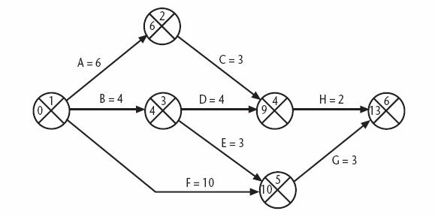
By Forward Pass,
Find the earliest date
Activity | Precedence | Duration (week)
A | - | 6
B | - | 4
C | A | 3
D | B | 4
E | B | 3
F | - | 10
G | E,F | 3
H | C,D | 2

Slide 77
6.16 Activity-On-Arrow Networks The Forward Pass [1/4]
Activities A, B and F may start immediately
The earliest date for event 1 is zero
The earliest start date for these three activities is also zero
Activity A will take 6 weeks
The earliest it can finish is week 6
The earliest we can achieve event 2 is week 6

Slide 78
6.16 Activity-On-Arrow Networks The Forward Pass [2/4]
Activity B will take 4 weeks
The earliest it can finish and the earliest we can achieve event 3 is week 4
Activity F will take 10 weeks
The earliest it can finish is week 10
We cannot tell whether or not this is also the earliest date that we can achieve event 5 since we have not, as yet, calculated when activity E will finish

Slide 79
6.16 Activity-On-Arrow Networks The Forward Pass [3/4]
Activity E can start as early as week 4 (the earliest date for event 3)
It is forecasted to take 3 weeks, it will be completed, at the earliest, at the end of week 7
Event 5 may be achieved when both E and F have been completed, that is week 10 (the later of 7 and 10)

Slide 80
6.16 Activity-On-Arrow Networks The Forward Pass [4/4]
Similarly, we can reason that event 4 will have an earliest date of week 9
The later of the earliest finish for activity D (week 8) and the earliest finish for activity C (week 9)
The earliest date for the completion of the project, event 6, is therefore the end of week 13
The later of 11 (the earliest finish for H) and 13 (the earliest finish for G)

Slide 81
6.16 Activity-On-Arrow Networks The CPM Network After The Forward Pass

Slide 82
Update the activity table
Activity | Duration (week) | Earliest start date | Latest start date | Earliest finish date | Latest finish date | Total float
A | 6 | 0 |  | 6
B | 4 | 0 |  | 4
C | 3 | 6 |  | 9
D | 4 | 4 |  | 8
E | 3 | 4 |  | 7
F | 10 | 0 |  | 10
G | 3 | 10 |  | 13
H | 2 | 9 |  | 11

Slide 83
6.16 Activity-On-Arrow Networks The Activity Table After The Forward Pass
Activity | Duration (week) | Earliest start date | Latest start date | Earliest finish date | Latest finish date | Total float
A | 6 | 0 |  | 6
B | 4 | 0 |  | 4
C | 3 | 6 |  | 9
D | 4 | 4 |  | 8
E | 3 | 4 |  | 7
F | 10 | 0 |  | 10
G | 3 | 10 |  | 13
H | 2 | 9 |  | 11

Slide 84
6.16 Activity-On-Arrow Networks The Backward Pass
Calculate the latest date at which each event may be achieved, each activity started and finished, without delaying the end of the project
The latest date for an event is the latest date by which all immediately following activities must be started for the project to be completed on time

Slide 85
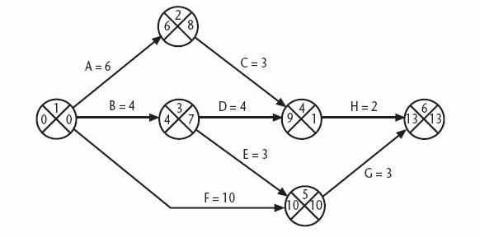
6.16 Activity-On-Arrow Networks The CPM Network After the Backward Pass

Slide 86
Update the activity table
Activity | Duration (week) | Earliest start date | Latest start date | Earliest finish date | Latest finish date | Total float
A | 6 | 0 | 8-6=2 | 6 | 8
B | 4 | 0 | 7-4=3 | 4 | 7
C | 3 | 6 | 11=3=8 | 9 | 11
D | 4 | 4 | 11-4=7 | 8 | 11
E | 3 | 4 | 10-3=7 | 7 | 10
F | 10 | 0 | 10-10=0 | 10 | 10
G | 3 | 10 | 13-3=10 | 13 | 13
H | 2 | 9 | 13-2=11 | 11 | 13
In Backward Pass, for node 1 (out of 2/3/0), and
node 3(out of 7/7), The earliest of the latest start dates
is picked.

Slide 87
6.16 Activity-On-Arrow Networks The Activity Table After the Backward Pass
Activity | Duration (week) | Earliest start date | Latest start date | Earliest finish date | Latest finish date | Total float
A | 6 | 0 | 2 | 6 | 8
B | 4 | 0 | 3 | 4 | 7
C | 3 | 6 | 8 | 9 | 11
D | 4 | 4 | 7 | 8 | 11
E | 3 | 4 | 7 | 7 | 10
F | 10 | 0 | 0 | 10 | 10
G | 3 | 10 | 10 | 13 | 13
H | 2 | 9 | 11 | 11 | 13

Slide 88
6.16 Activity-On-Arrow Networks Identifying The Critical Path
The critical path is identified in a way similar to that used in activity-on-node networks
A different concept is used: slack
A slack is the difference between the earliest date and the latest date for an event
It is a measure of how late an event may be

Slide 89
6.16 Activity-On-Arrow Networks The Activity Table After the Backward Pass
Activity | Duration (week) | Earliest start date | Latest start date | Earliest finish date | Latest finish date | Total float
A | 6 | 0 | 2 | 6 | 8 | 8-6=2
B | 4 | 0 | 3 | 4 | 7 | 7-4=3
C | 3 | 6 | 8 | 9 | 11 | 11-9=2
D | 4 | 4 | 7 | 8 | 11 | 11-8=3
E | 3 | 4 | 7 | 7 | 10 | 10-7=3
F | 10 | 0 | 0 | 10 | 10 | 10-10=0
G | 3 | 10 | 10 | 13 | 13 | 13-13=0
H | 2 | 9 | 11 | 11 | 13 | 13-11=2

Slide 90
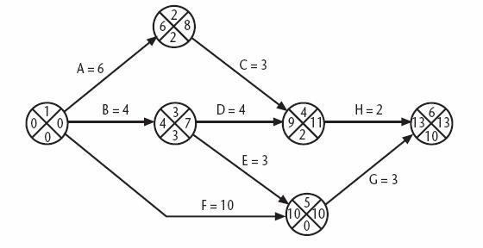
6.16 Activity-On-Arrow Networks The Critical Path
The critical path is the path joining all nodes with a zero slack

Slide 91
6.17 Conclusion [1/3]
Activity plan tells us the order in which we should execute activities and the earliest and latest we can start and finish them
The critical path method and precedence networks can be used to obtain an ideal activity plan

Slide 92
6.17 Conclusion [2/3]
The critical path method and precedence networks techniques helps us to identify which activities are critical to meeting a target completion date
In order to manage the project we need to turn the activity plan into schedule that will specify precisely when each activity is scheduled to start and finish

Slide 93
6.17 Conclusion [3/3]
Before we can do scheduling, we must consider what resources will be required and whether or not they will be available at appropriate times
The allocation of resources to an activity may be affected by how we view the importance of the task and the risks associated with it

Slide 94
SOME MORE Ex.
Activity | Predecessor | Duration | Earliest start | Latest start=Latest Finish-Duration | Earliest Finish=duration + earliest start | Latest Finish | total float
A | - | 2 | 0 | 2-2=0 | 2 | 2 | 0
B | - | 3 | 0 | 3-3=0 | 3 | 3 | 0
C | A | 4 | 2 | 6-4=2 | 6 | 6 | 0
D | A,B | 3 | 3 | 6-3=3 | 6 | 6 | 0
E | D,C | 8 | 6 | 14-8=6 | 14 | 14 | 0
F | C | 3 | 6 | 13-3=10 | 9 | 13 | 4
G | E | 2 | 14 | 16-2=14 | 16 | 16 | 0
H | F | 3 | 9 | 16-3=13 | 12 | 16 | 2

Slide 95
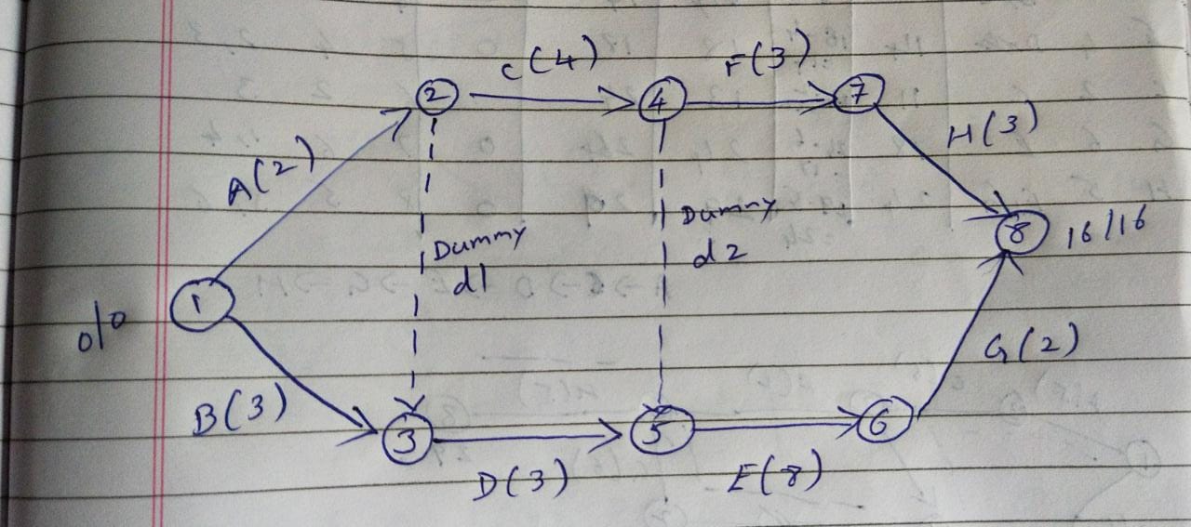
Critical Path 1 : 1->2->4->5->6->8
Critical Activity: A, C, d2(dummy), E,G
Critical Path 2 : 1->3->5->6->8
Critical Activity: B,D,E,G

